Slide 1



PEILab Group Meeting
Leader: Zicong Hong
Team Member: Jian Lin, Haodong Wang, Qianli Liu, Kaibin Guo, Junjie Liu

Slide 2
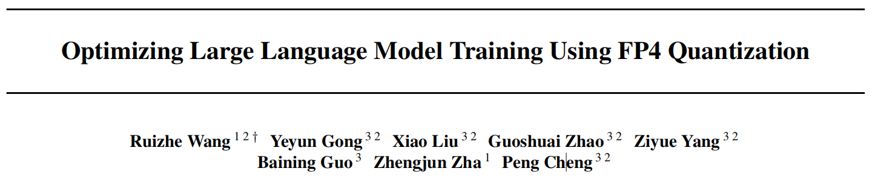
ICML’25

Slide 3
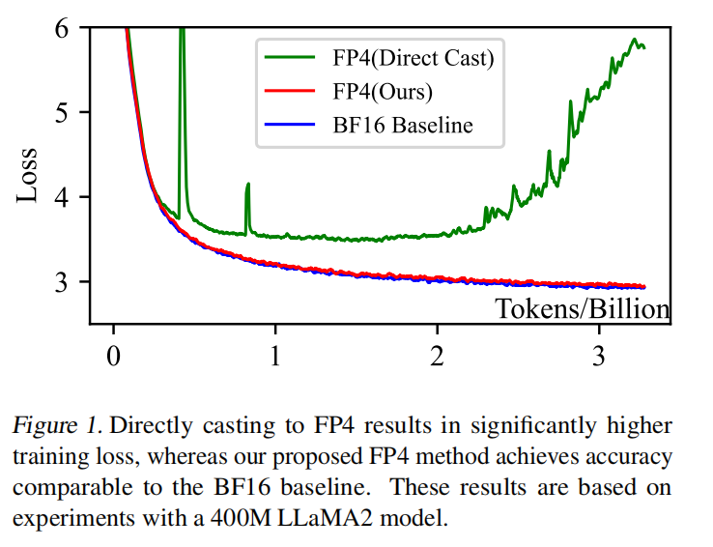

Slide 4
